Slide 1


Basics of Hearing Assessment
Bethany Wenger, Au.D., CCC-A, FAAA
AAP QI Phase 2 Webinar
March 14, 2017
Notes:
90 mins
3 Training Objectives
Participants will learn about how the ear works and how degrees of hearing loss affect speech and language perception
Participants will gain an understanding of different methods of assessing hearing in young children
Participants will learn about why routine hearing screening is important, and how the Head Start hearing screening program uniquely helps children.
3 Expected Learning Objectives
Participants will be able to identify effects of unmanaged hearing loss on child development, behavior, and school readiness.
Participants will be able to describe how to perform a hearing screening in a Head Start setting using objective measures, and where to obtain further training.
Participants will be able to list all components of Head Start’s recommended hearing screening protocol, and the rationale for each step.

Slide 2
Overview
Types of Hearing Loss
Methods of Assessing Hearing
OAE vs AABR/ABR Newborn Hearing Screenings
Notes:
The Ear and Audiology
Types/degrees of hearing loss, how to read an audiogram, why “I know they can hear me” isn’t enough
Causes of Childhood Hearing Loss
__% of kids w/ HL have comorbid condition
Effects of Childhood Hearing Loss
Working with Clients with Hearing Loss
Working with hearing aids
Supporting ASL
Identifying Clients Who May Need a Hearing Test

Slide 3
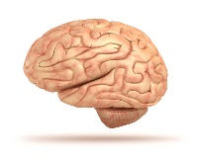
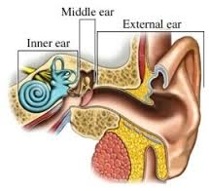
Types of Hearing Loss
External (Outer) and/or Middle Ear
  Conductive Hearing Loss
Inner ear and/or Nerve
  Sensorineural Hearing Loss
Both Conductive & Sensorineural
  Mixed Hearing Loss
Sound
http://www.harthosp.org/hearing/HowtheEarWorks/default.aspx
Notes:
Parts of the ear
Sound has to travel through this entire system (description)
dysfunction can occur at any point and cause hearing loss (examples)
Descriptions on right

Slide 4
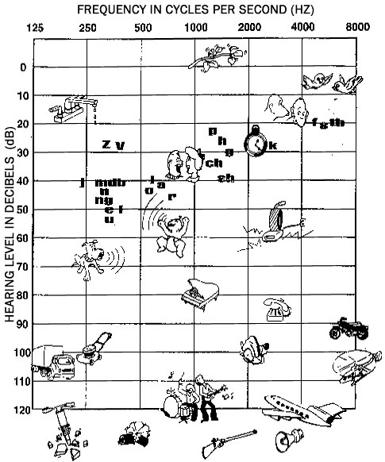
How do we measure hearing?
Low pitch --------------------> High pitch
How well can you hear lots of different tones?
  Frequency (“pitch”)
    Hertz, or Hz
  Volume
    Decibels, or dB
Determine the softest sounds that each ear can hear
  O = right ear
  X = left ear
Loud <----------------------------- Soft
Notes:
Discuss:
When we think about hearing and hearing loss, we’re interested in how well a person can hear lots of different tones
Think back to your hearing tests that you did during school—raise your hand when you hear the beep
We’re checking how softly you can hear low-pitch beeps up to high-pitch beeps
We chart hearing on a graph like this: frequency/pitch goes across the top, like a piano keyboard (measured in hertz)
Volume scale, measured in decibels, is on the left
The reason we’re interested in these characteristics is because of the pictures you see on here
That’s because sounds in our world have different tones and different volumes—we want to make sure you’re hearing all of them
Sounds in our world…. Some are low-pitch and soft, etc.
Speech sounds count… some are low-pitch, some are high-pitch
You can have hearing loss at all of these tones… or maybe just some tones. Just because you can hear some sounds does not mean that you have completely normal hearing. I always tell parents that there’s a range of how well we can hear, just like there’s a range of how well we can see.
When we do a hearing test, we’re interested in how well you can hear ALL of these different tones in BOTH ears
I’ll play a tone and start lowering the volume, and I want to see—did they respond within normal limits? Or did the volume need to be louder than normal for them to respond?
Like the vision screening… we’re not just looking for people who are completely blind/deaf; we’re checking if you have “20/20” function.

Slide 5
How do we measure hearing?
Low pitch --------------------> High pitch
How well can you hear lots of different tones?
  Frequency (“pitch”)
    Hertz, or Hz
  Volume
    Decibels, or dB
Determine the softest sounds that each ear can hear
  O = right ear
  X = left ear
NORMAL
Loud <----------------------------- Soft
Notes:
Discuss:
When we think about hearing and hearing loss, we’re interested in how well a person can hear lots of different tones
Think back to your hearing tests that you did during school—raise your hand when you hear the beep
We’re checking how softly you can hear low-pitch beeps up to high-pitch beeps
We chart hearing on a graph like this: frequency/pitch goes across the top, like a piano keyboard (measured in hertz)
Volume scale, measured in decibels, is on the left
The reason we’re interested in these characteristics is because of the pictures you see on here
That’s because sounds in our world have different tones and different volumes—we want to make sure you’re hearing all of them
Sounds in our world…. Some are low-pitch and soft, etc.
Speech sounds count… some are low-pitch, some are high-pitch
You can have hearing loss at all of these tones… or maybe just some tones. Just because you can hear some sounds does not mean that you have completely normal hearing. I always tell parents that there’s a range of how well we can hear, just like there’s a range of how well we can see.
When we do a hearing test, we’re interested in how well you can hear ALL of these different tones in BOTH ears
I’ll play a tone and start lowering the volume, and I want to see—did they respond within normal limits? Or did the volume need to be louder than normal for them to respond?
Like the vision screening… we’re not just looking for people who are completely blind/deaf; we’re checking if you have “20/20” function.

Slide 6
How do we measure hearing?
Low pitch --------------------> High pitch
NORMAL
Degrees of Hearing Loss:
Mild
Moderate
Moderately-severe
Severe
Profound
Loud <----------------------------- Soft
Notes:
If the volume had to be louder than normal before they heard it, that means hearing loss. I assign a degree of hearing loss based on how far outside normal limits it was.

Slide 7
Degrees of Hearing Loss
Low pitch --------------------> High pitch
Example: Normal hearing sloping to a moderate hearing loss
  Or “moderate high-frequency hearing loss”
Loud <----------------------------- Soft
Notes:
A person with hearing loss might hear some sounds better than others
Articulation Index: 44% (based on count-the-dots)

Slide 8
Degrees of Hearing Loss
Low pitch --------------------> High pitch
Example: Normal hearing sloping to a moderate hearing loss
  Or “moderate high-frequency hearing loss”
O
O
NORMAL LIMITS
O
O
Loud <----------------------------- Soft
O
O
THRESHOLD
Notes:
A person with hearing loss might hear some sounds better than others
Articulation Index: 44% (based on count-the-dots)

Slide 9
Degrees of Hearing Loss
Low pitch --------------------> High pitch
Example: Normal hearing sloping to a moderate hearing loss
  Or “moderate high-frequency hearing loss”
O
O
NORMAL LIMITS
O
O
Loud <----------------------------- Soft
O
O
THRESHOLD
CAN HEAR
Notes:
A person with hearing loss might hear some sounds better than others
Articulation Index: 44% (based on count-the-dots)

Slide 10
Degrees of Hearing Loss
Low pitch --------------------> High pitch
Example: Normal hearing sloping to a moderate hearing loss
  Or “moderate high-frequency hearing loss”
CANNOT HEAR
O
O
NORMAL LIMITS
O
O
Loud <----------------------------- Soft
O
O
THRESHOLD
CAN HEAR
Notes:
A person with hearing loss might hear some sounds better than others
Articulation Index: 44% (based on count-the-dots)

Slide 11
Degrees of Hearing Loss
Low pitch --------------------> High pitch
Example: Normal hearing sloping to a moderate hearing loss
  Is this child going to hear and react to sounds?
O
O
O
O
Loud <----------------------------- Soft
O
O
Notes:
A person with hearing loss might hear some sounds better than others
Articulation Index: 44% (based on count-the-dots)

Slide 12
Degrees of Hearing Loss
Low pitch --------------------> High pitch
Example: Normal hearing sloping to a moderate hearing loss
  Is this child going to hear and react to sounds?
O
O
O
O
Loud <----------------------------- Soft
O
O
CAN HEAR
Notes:
A person with hearing loss might hear some sounds better than others
Articulation Index: 44% (based on count-the-dots)

Slide 13
Degrees of Hearing Loss
Low pitch --------------------> High pitch
Example: Normal hearing sloping to a moderate hearing loss
  Is this child going to hear and react to sounds?
  Will he react to someone talking?
O
O
O
O
Loud <----------------------------- Soft
O
O
Notes:
A person with hearing loss might hear some sounds better than others
Articulation Index: 44% (based on count-the-dots)

Slide 14
Degrees of Hearing Loss
Low pitch --------------------> High pitch
Example: Normal hearing sloping to a moderate hearing loss
  Is this child going to hear and react to sounds?
  Will he react to someone talking?
O
O
O
O
Loud <----------------------------- Soft
O
O
Notes:
A person with hearing loss might hear some sounds better than others
Articulation Index: 44% (based on count-the-dots)

Slide 15
Degrees of Hearing Loss
Low pitch --------------------> High pitch
Example: Normal hearing sloping to a moderate hearing loss
  Is this child going to hear and react to sounds?
  Will he react to someone talking?
  Will he learn speech and language as expected?
O
O
O
O
Loud <----------------------------- Soft
O
O
Notes:
A person with hearing loss might hear some sounds better than others
Articulation Index: 44% (based on count-the-dots)

Slide 16
Degrees of Hearing Loss
Low pitch --------------------> High pitch
Example: Normal hearing sloping to a moderate hearing loss
  Is this child going to hear and react to sounds?
  Will he react to someone talking?
  Will he learn speech and language as expected?
O
O
O
O
Loud <----------------------------- Soft
O
O
Notes:
A person with hearing loss might hear some sounds better than others
Articulation Index: 44% (based on count-the-dots)

Slide 17
Degrees of Hearing Loss
Low pitch --------------------> High pitch
Example: Normal hearing sloping to a moderate hearing loss
  Is this child going to hear and react to sounds?
  Will he react to someone talking?
  Will he learn speech and language as expected?
    Amount of speech that is audible: 44%
O
O
O
O
Loud <----------------------------- Soft
O
O
Notes:
A person with hearing loss might hear some sounds better than others
Articulation Index: 44% (based on count-the-dots)

Slide 18
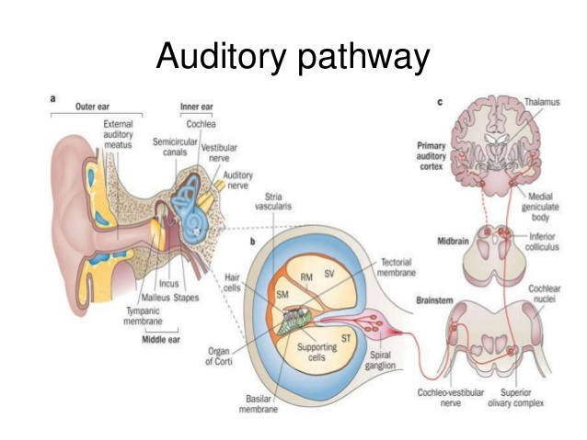
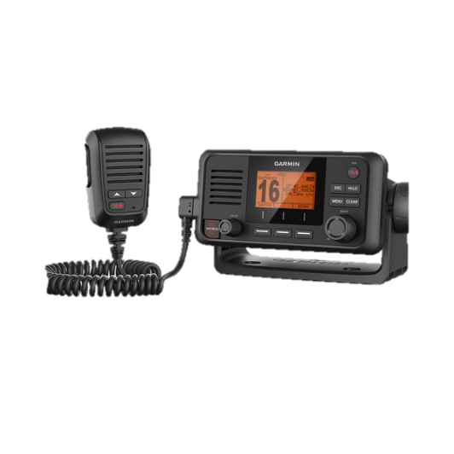
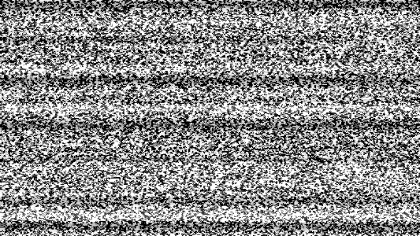
Auditory Neuropathy (AN/ANSD)
Even if sound is detected at normal levels, it must be sent to the brain by the auditory nerve
  Accurate signal transmission depends on synchronous neural firing
  If not: poor speech understanding ability (especially in noise)
Hearing thresholds may be normal, abnormal, or fluctuating
  Animal studies have shown 50-80% nerve sections w/normal hearing thresholds¹
  Some people’s hearing thresholds change with body temperature²
¹Schuknecht, H. F., & Woellner, R. C. (1953). Hearing losses following partial section of the cochlear nerve. The Laryngoscope, 63(6), 441-465.
²Starr, A., Sininger, Y., Winter, M., Derebery, M. J., Oba, S., & Michalewski, H. J. (1998). Transient deafness due to temperature-sensitive auditory neuropathy. Ear and hearing, 19(3), 169-179.

Slide 19
How do we test children?
Method depends on age, developmental abilities, and what results are obtained during the session
  No child is too young to test or diagnose with hearing loss!

Slide 20
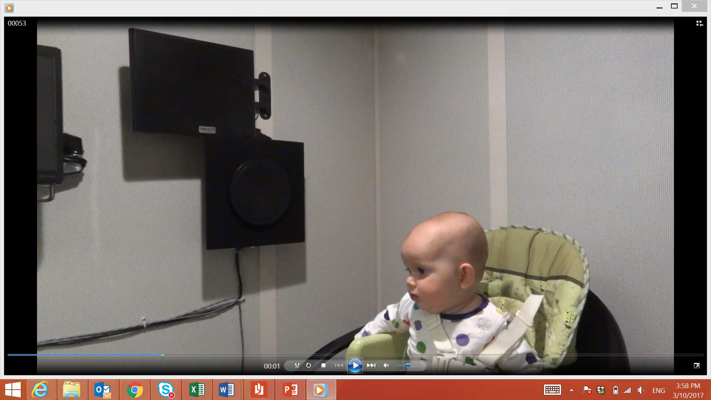
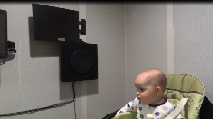

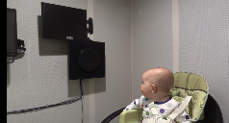
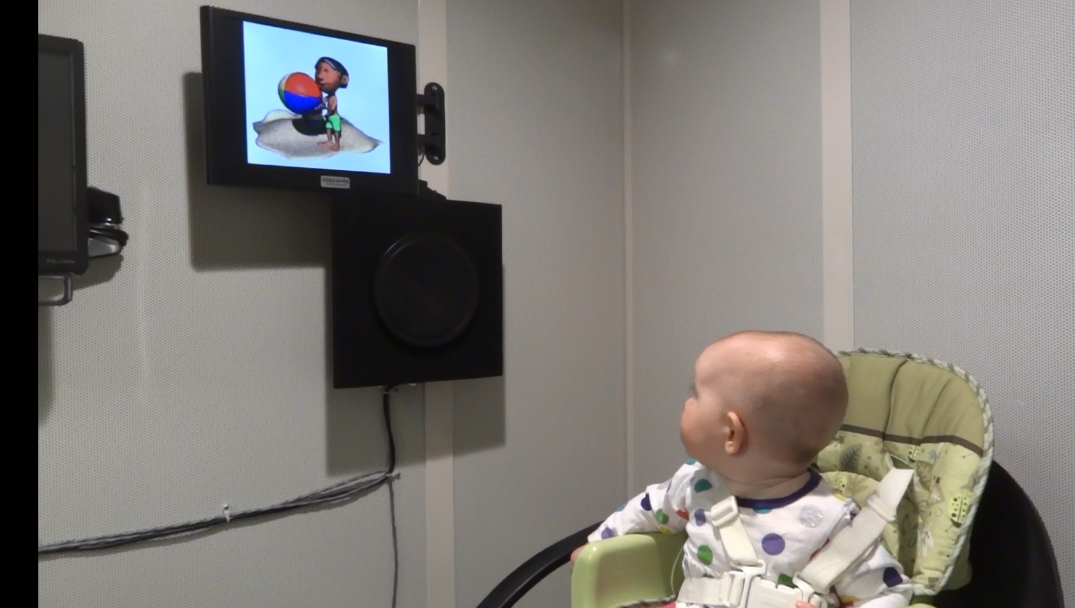
Hearing Tests
Behavioral = gold standard
  Tests the entire auditory system
  Patient gives a behavioral response to a sound (show us what is heard)
Behavioral procedures
  Visual Reinforcement Audiometry
    Approx. ages 7mo-2.5yrs
    Often soundfield and ear-specific
Dahlia, age 7 months
Capstone Pediatrics

Slide 21

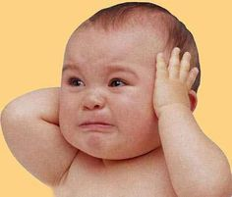
Hearing Tests
Behavioral = gold standard
  Tests the entire auditory system
  Patient gives a behavioral response to a sound (show us what is heard)
Behavioral procedures
  Visual Reinforcement Audiometry
    Approx. ages 7mo-2.5yrs
    Often soundfield and ear-specific
Dahlia, age 7 months
Capstone Pediatrics

Slide 22
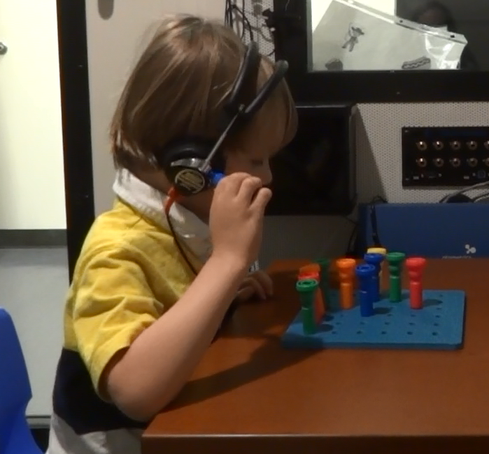
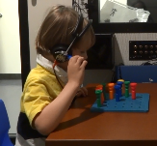

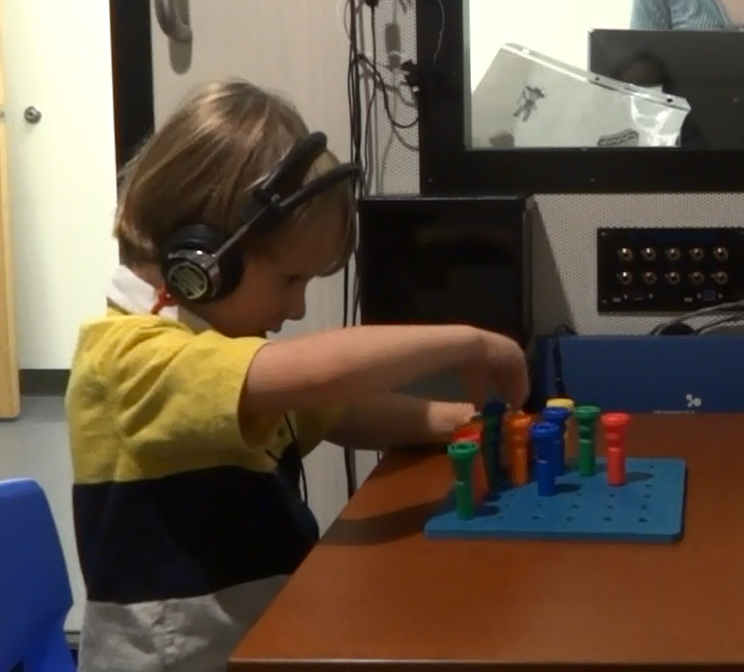
Hearing Tests
Behavioral = gold standard
  Tests the entire auditory system
  Patient gives a behavioral response to a sound (show us what is heard)
Behavioral procedures
  Visual Reinforcement Audiometry
    Approx. ages 7mo-2.5yrs
    Often soundfield and ear-specific
  Conditioned Play Audiometry
    Approx. ages 2.5yrs-5 yrs
Gaven, age 3.5 years
Capstone Pediatrics

Slide 23
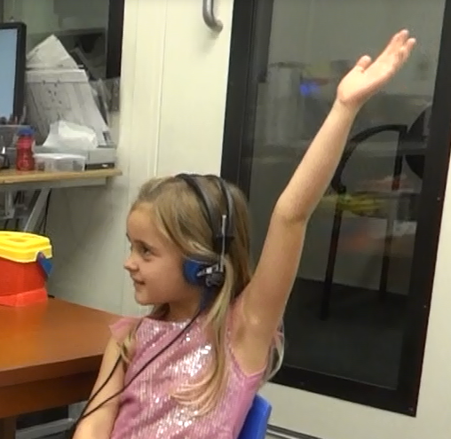
Hearing Tests
Behavioral = gold standard
  Tests the entire auditory system
  Patient gives a behavioral response to a sound (show us what is heard)
Behavioral procedures
  Visual Reinforcement Audiometry
    Approx. ages 7mo-2.5yrs
    Often soundfield and ear-specific
  Conditioned Play Audiometry
    Approx. ages 2.5yrs-5 yrs
  Standard/Conventional
    Approx. ages 5 yrs+
Kara, age 4.5 years
Capstone Pediatrics

Slide 24
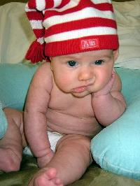
Behavioral Observation (Audiometry)
BOA
Usual ages 0-5 months (or older)
Look for infant to react in some way to sound (unconditioned response)
  Eye widening, change in sucking, startle
POOR reliability
HIGHLY influenced by infant state (wakefulness, habituation) and tester interpretation
UNABLE to determine hearing thresholds

Slide 25
Behavioral Observation (Audiometry)
From the American Academy of Audiology protocol (emphasis mine):
  Purposes: To assist in the determination of global auditory skill development. This method is inappropriate for hearing screening or estimating auditory thresholds, or for selecting, modifying or verifying amplification.
  Expected Outcome: Observation of behavioral responses to auditory stimuli may contribute to the global assessment of auditory skill development.
  Reporting Requirements: […] The results should be characterized as observational and not intended as predictive of auditory thresholds.
You may see this in reports… be aware of purpose and limitations.
“Audiologic Guidelines for the Assessment of Hearing in Infants and Young Children” (2012), American Academy of Audiology

Slide 26
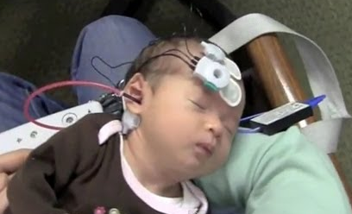
Hearing Tests
Objective measures supplement behavioral information
  Non-behavioral responses (for example, looking at brainstem activity when sound is played)
  e.g., OAEs and ABR/AABR
Newborn receiving an Auditory Brainstem Response test
www.youtube.com/watch?v=QvrBogzziXA

Slide 27
Additional Tests
Immittance
  Tympanometry
  Acoustic Reflexes
Speech Testing
Otoacoustic Emissions
  OAE
Auditory Brainstem Response
  ABR or AABR
Diagnostic and screening versions
Screening versions used for Newborn Hearing Screening (OAEs: also can screen older children)

Slide 28
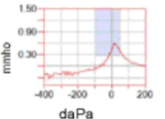
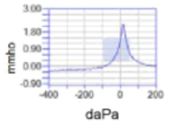
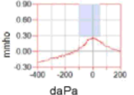
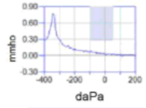
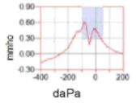
Immittance : Tympanometry
Evaluates middle ear pressure and compliance
  Type A = normal
  Type Ad = normal pressure, hypercompliance
  Type As = normal pressure, reduced compliance
  Type C = significant (negative) pressure
  Type W = double-peaked
  Type B = no measurable eardrum movement
A
Ad
As
C
W
Notes:
NOT a hearing test!

Slide 29
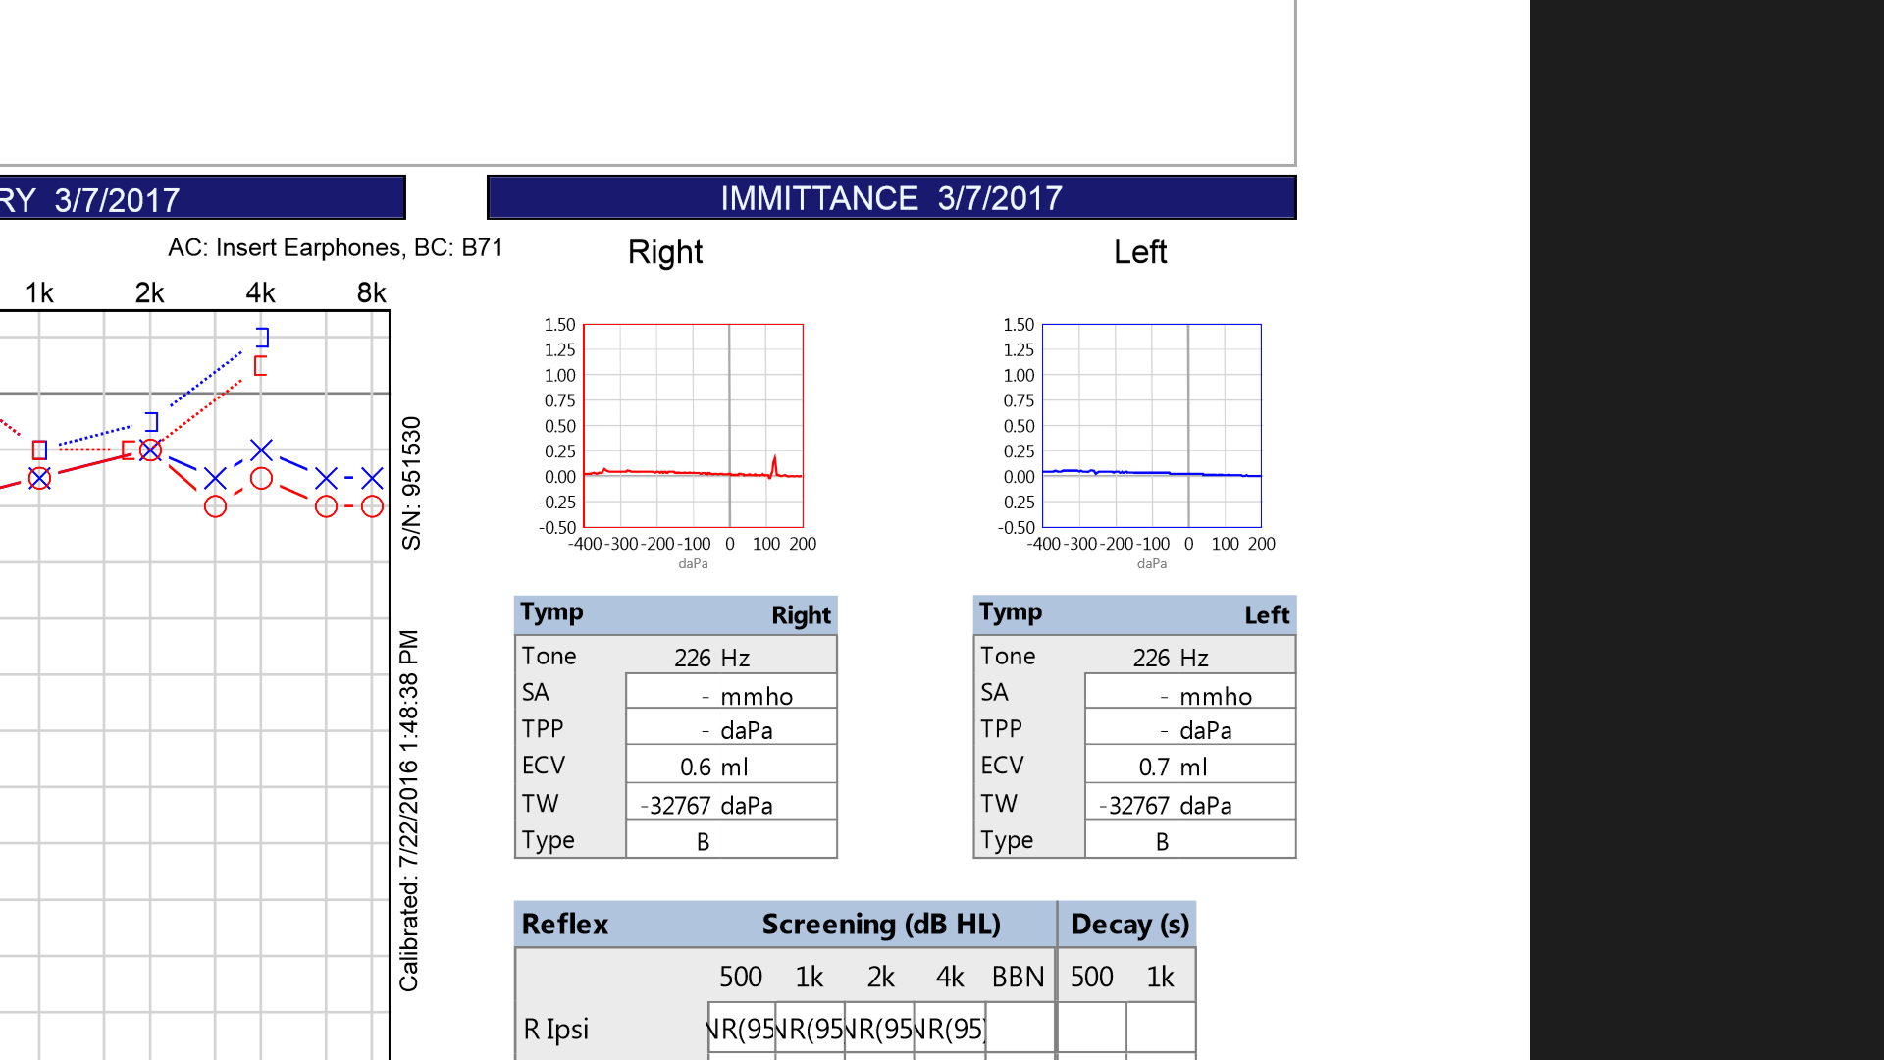
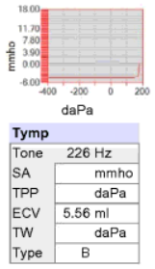
Immittance : Tympanometry
Also measures ear canal volume
  No movement + enlarged volume = perforation or patent PE tube
  Type B: need to know volume
For infants < approx. 6 months, need to use a high-frequency probe tone (e.g., 1000 Hz)
  Ear canal not ossified
  Usual low-frequency tone -> measures movement of ear canal, rather than tympanic mobility
Large ear canal volume (measuring middle ear space) w/no eardrum mvmt= perf/patent PE tube
Notes:
NOT a hearing test!

Slide 30
Immittance : Acoustic Reflexes
Loud sound stimulates CN VIII to fire, generating bilateral muscle reflex in middle ear
  Ascending pathway: CN VIII
  Descending pathway: CN VII, stapedial muscle
Present reflexes (at normal levels) indicate function of CN VIII
  i.e., rule out auditory neuropathy
Normal reflex = grossly normal FUNCTION through here
(stimulus is very loud: does NOT rule out all hearing loss)

Slide 31
Immittance : Acoustic Reflexes
Absent/abnormal reflexes can indicate:
  Neural dysfunction (VIII and/or VII)
  Middle ear pathology
  Hearing loss
Like tympanometry, infants < approx. 6 months require a high-frequency probe tone (e.g., 1000 Hz)
  Ear canal not ossified
  Usual low-frequency tone -> measures movement of ear canal, rather than contraction of stapedial muscle
Normal reflex = grossly normal FUNCTION through here
(stimulus is very loud: does NOT rule out all hearing loss)

Slide 32
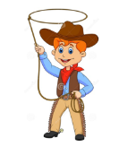
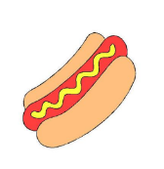


Speech Threshold Testing
Speech Awareness Threshold or Speech Detection Threshold (SAT, SDT)
Speech Recognition Threshold (SRT) – identifying spondees
  Repeating vs picture-pointing
Recorded vs. monitored live voice
Should align with pure-tone average (average thresholds 500-2000 Hz) on audiogram
Notes:
Would you be willing/interested in teaching the pediatric hearing testing/screening lecture to the MDE class this fall? It’s MDE students, SLP students on the specialty track and SLP students without a background. The class is 2 hours and date/readings are as follows:
09/17/15 – Assessing hearing in Children & Principles of Screening
Readings: Humes & Bess, pages 251 – 327

Slide 33
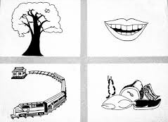
Supra-threshold Speech Testing
Word Recognition (WR), Speech-in-Noise (SIN)
Starting at approximately age 3 yrs
Indicates retrocochlear pathology, potential benefit from additional volume, difficulties with auditory processing, etc.
With or without noise
Recorded vs monitored live voice
Picture-pointing vs repeating
NU-CHIPS, http://www.auditec.com
Notes:
Would you be willing/interested in teaching the pediatric hearing testing/screening lecture to the MDE class this fall? It’s MDE students, SLP students on the specialty track and SLP students without a background. The class is 2 hours and date/readings are as follows:
09/17/15 – Assessing hearing in Children & Principles of Screening
Readings: Humes & Bess, pages 251 – 327

Slide 34
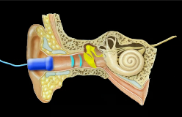
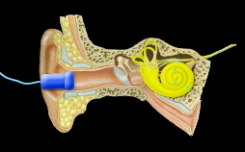
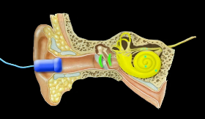
Otoacoustic Emissions (OAEs)
Sound enters the ear…
…travels to the brain and is heard…
…and a healthy cochlea generates its own measurable sound in response.
Images from http://www.infanthearing.org/flashvideos/ECHO/HowOAEWorks.mp4

Slide 35
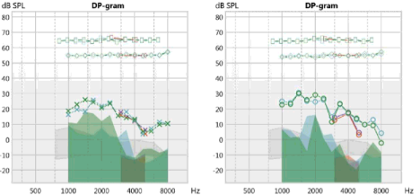
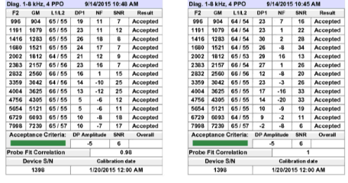
Otoacoustic Emissions (OAEs)
Sound produced by (healthy) outer hair cells of the cochlea
  If present emissions: cochlear hearing sensitivity likely normal or (at worst) a mild loss
  If absent: can mean worse-than-mild hearing loss
  Can also be absent due to middle ear dysfunction, wax, noise/movement, etc.
  See “Screening” for more info
3 types:
  Distortion Product (DPOAEs)
  Transient Evoked (TEOAEs)
  Spontaneous (SOAEs)

Slide 36

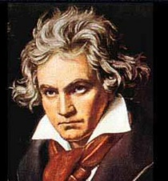
Audible DPOAE Examples
www.earslap.com/article/combination-tones-and-the-nonlinearities-of-the-human-ear.html
Loud 1000 Hz and 1200 Hz
Very soft, low-frequency 200 Hz distortion product may be audible in background (sounds like humming/electrical)
5 sec.
Loud modulated tones
Very soft “Ode to Joy” in the background is generated by your cochleae (not part of the stimulus!)
18 sec.

Slide 37
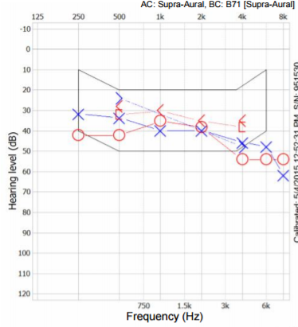
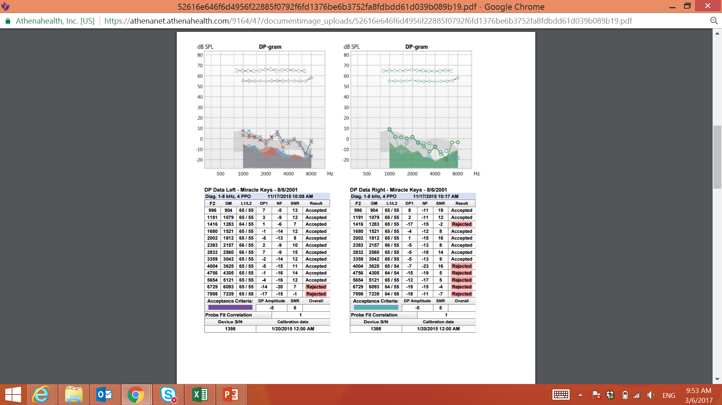
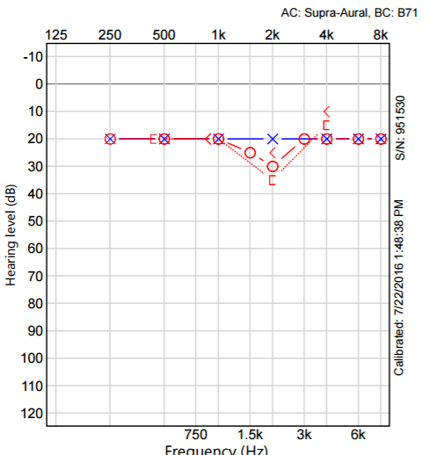
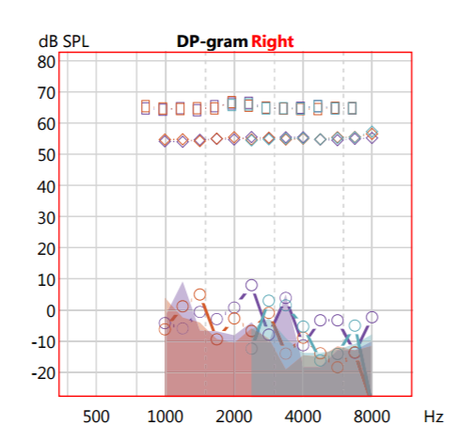
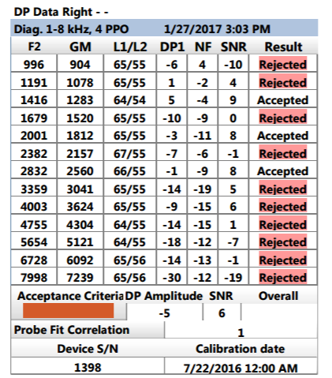
Otoacoustic Emissions (OAEs)
14 yr old, has hearing aids
14 Yr Old, has noise exposure

Slide 38
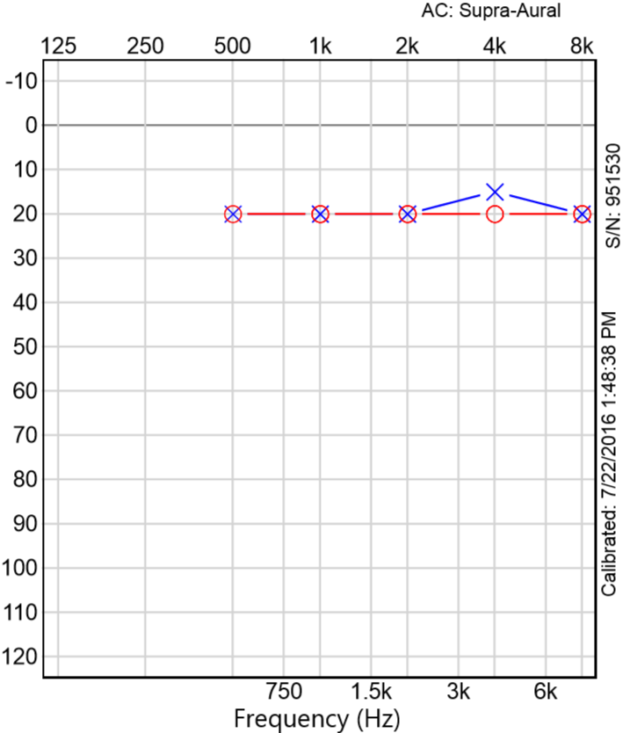
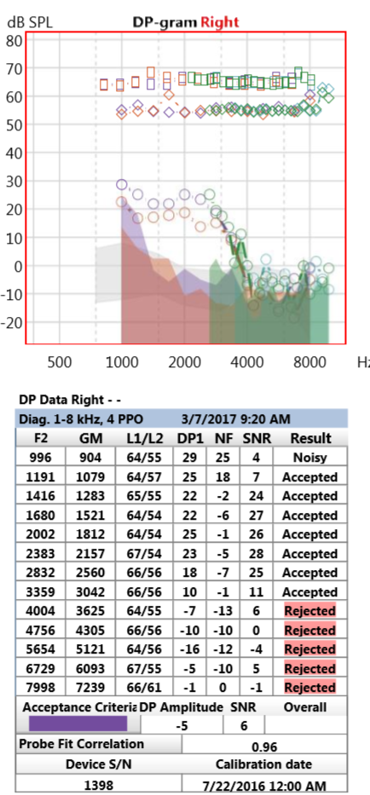
Otoacoustic Emissions (OAEs)
14 yr old, has hearing aids
3 Yr Old (former 28wk gest.)

Slide 39
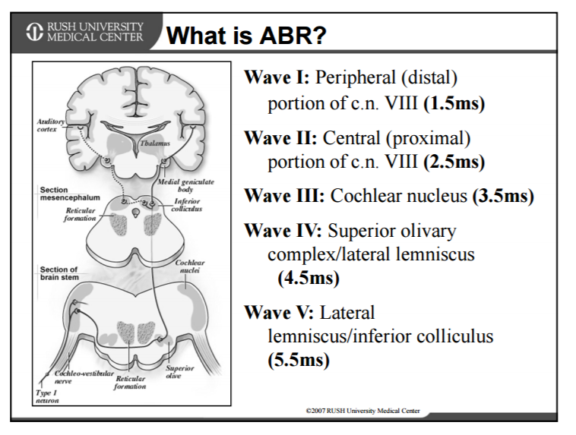
Auditory Brainstem Response (ABR)
Auditory evoked potential
Measures response to sound at level of brainstem
  Diagnose auditory neuropathy
  Estimate hearing sensitivity
Winston, A.K., & Stoner, R.B. (2013, November). ABR: An illustration of auditory dysfunction through clinical cases, presented in partnership with Rush University. AudiologyOnline, Article 12179. Retrieved from: http://www.audiologyonline.com

Slide 40
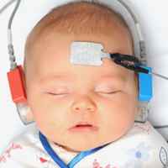
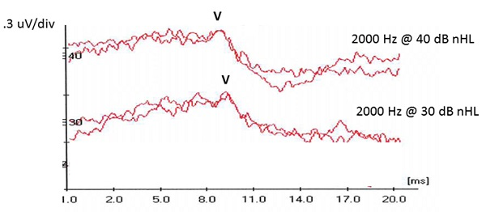
Auditory Brainstem Response (ABR)
Diagnostic
  Very young children (esp. 0-6 mo)
  Older children/adults who cannot complete traditional testing
Screening
  click stimulus
  “Automated Auditory Brainstem Response” (AABR)
Sedated vs Unsedated
Click vs Tones
Wolfe, J. (2014, October). 20Q: ABR assessment in infants - protocols and standards. AudiologyOnline, Article 12999. Retrieved from: http://www.audiologyonline.com

Slide 41
Auditory Steady-State Response (ASSR)
Usually combined with other procedures
  i.e., when ABR is abnormal
Can test thresholds beyond limits of ABR
  Determine severe-to-profound thresholds
  (hearing aid vs. cochlear implant?)
Cannot distinguish neural vs. sensory hearing loss

Slide 42
Auditory Neuropathy (AN/ANSD)
Diagnostic gold standard: ABR
  Newborn hearing screenings: AABR will detect this condition, OAE will not
Usual clinical tests of neural function
  Acoustic reflexes
  Suprathreshold speech testing
    Not available under age 3 years

Slide 43
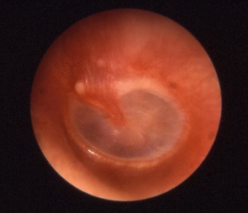
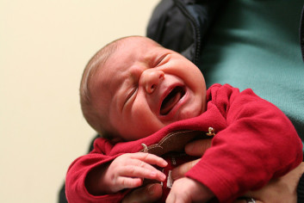
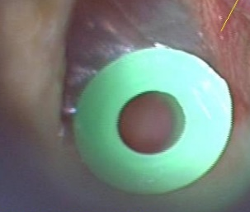
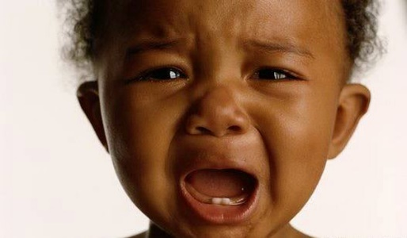
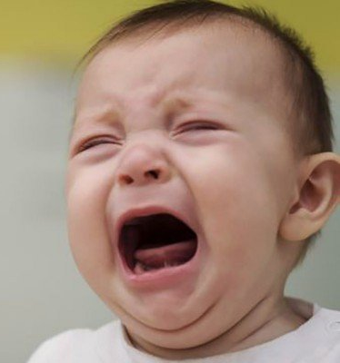
Acoustic Reflexes
Loud sound presented via hermetically-sealed probe in ear canal
  Evokes stapedial reflex arc = normal function of auditory nerve
Dependent on normal middle ear function (and no patent PE tube)
Dependent on compliant patient
Absent in small percentage of patients with normal neural function

Slide 44
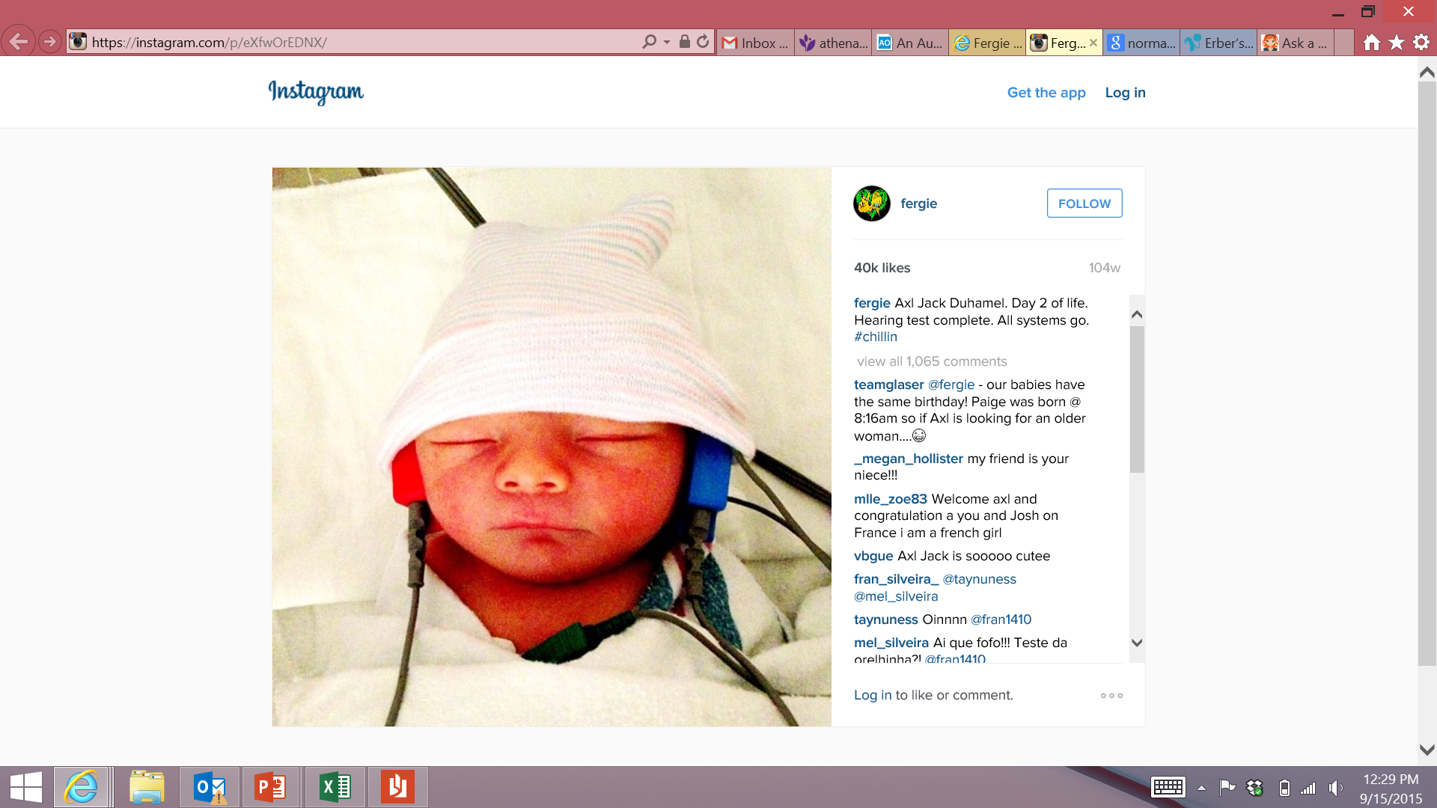
Newborn Hearing Screening
OAEs
  Will miss auditory neuropathy
  Well-baby only
  DPOAEs, TEOAEs
(A)ABR
  Click stimulus (targets high-frequencies)
  Well-baby and NICU (higher rates of neural dysfunction)

Slide 45
Newborn Hearing Screening
Both methods will miss a mild hearing loss, or a hearing loss affecting isolated frequency regions
Both methods are highly accurate, but can be affected by fluid in the ear (childbirth fluid = “vernix”)
AABR/ABR
OAEs
Adapted from http://www.slideshare.net/Daritsetseg/brainstem-auditory-evoked-responses-baer-or-abr

Slide 46

OAE Screening Training Website
kidshearing.org
  (redirects to www.infanthearing.org/
  earlychildhood)

Slide 47
OAE Screening Training Website
VERY comprehensive website about:
  Setting up a screening program
  Conducting OAE screenings
  Documenting results
  Referring children for additional evaluation
EVERYTHING is here…
  (... but it can be a little overwhelming at first)

Slide 48
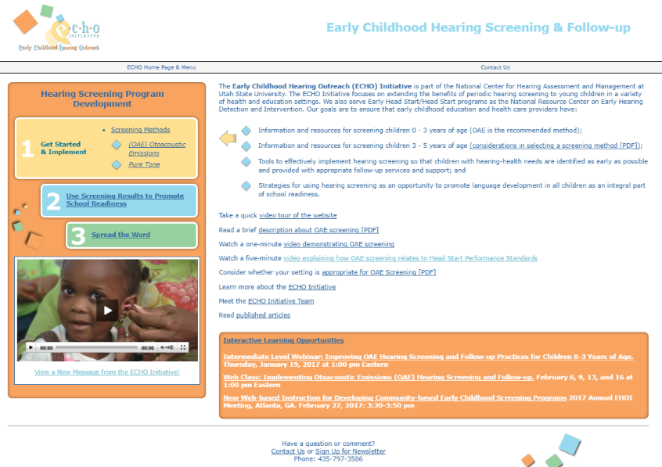

Slide 49


Slide 50
OAE videos
How OAE works
OAE screening step-by-step

Slide 51
How to screen OAEs
Check ECHO website (or machine’s manual) for specifics about how to run your machine
  If you’re getting a lot of “probe fit” error messages—clean the probe
Machine will display PASS or REFER/FAIL
  “Refer” = “referred for more testing” (i.e., nicer way to say “failed”)
  I prefer to say “did not pass” (nicer than “fail”, parents might not understand “refer”)
Check ECHO website for tips on conducting screenings
  How to distract/quiet child, etc.
ECHO website recommends partnering with a pediatric audiologist

Slide 52

Pediatric Audiology Facilities
Department of Health
EHDI-PALS
  www.ehdi-pals.org

Slide 53
Questions?
bwenger@capstonepediatrics.com
Thank you!

