Slide 1
Building Buy In
Amanda Norton, MSW
Improvement Advisor

Slide 2
Adoption of Ideas
“The part of the diffusion curve from about 10 percent to 20 percent adoption is the heart of the diffusion process. After that point, it is often impossible to stop the further diffusion of a new idea, even if one wished to do so.”
E.M. Rogers, Diffusion of Innovations (1995
34%
34%
13.5%
16%
2.5%
Early
Adopters
Early
Majority
Late
Majority
Innovators
Laggards

Slide 3
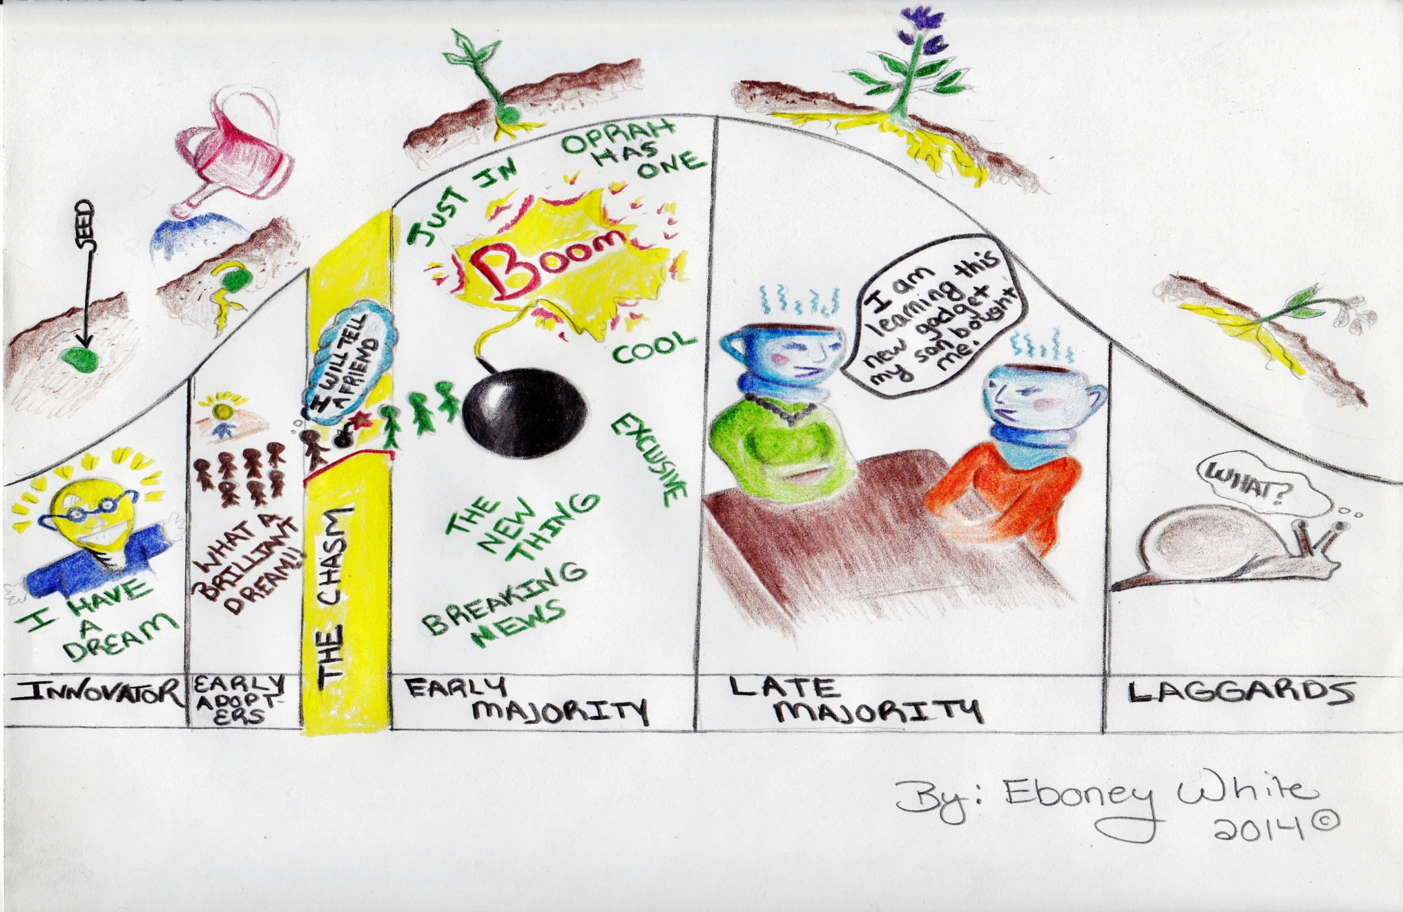

Slide 4
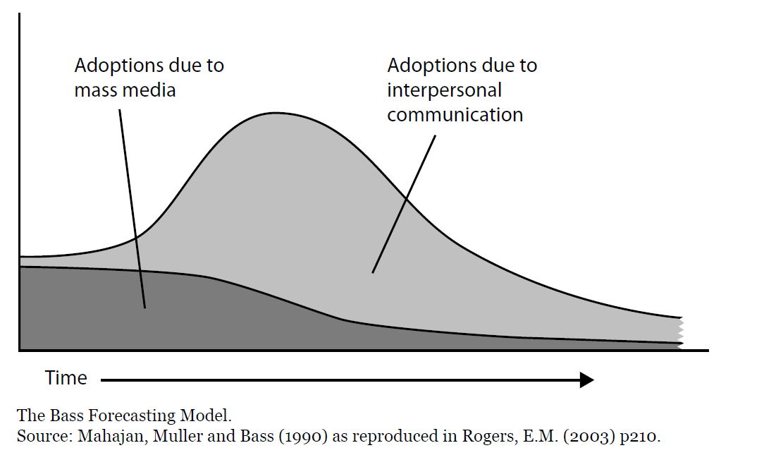

Slide 5
Ways to Communicate
SHARE
INFORMATION
SHAPE
BEHAVIOUR
General
Publications
flyers
newsletters
videos
articles
posters
Personal
Touch
letters
cards
postcards
Interactive
Activities
telephone
email
visits
seminars
learning sets
modeling
Public
Events
Road shows
Fairs
Conferences
Exhibitions
Mass meetings
Face-to-face
one-to-one
mentoring
seconding
shadowing
(C) 2001, Sarah W. Fraser
Adapted from Ashkenas, 1995
Notes:
-ones to right make them actually chg behaviors (collaboration fit here) people don’t chg behavior based on newsletters

Slide 6
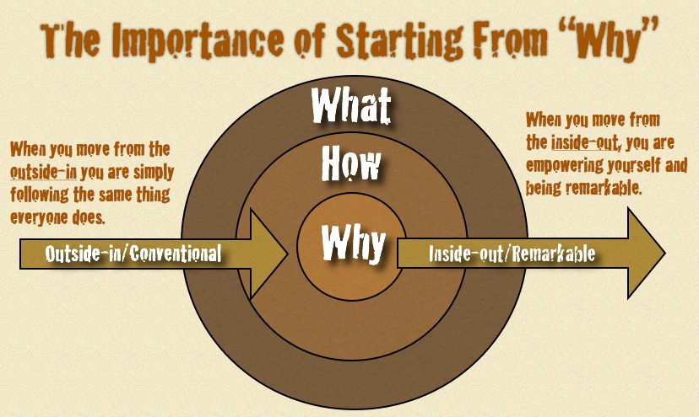
“People don’t buy what you do, they buy why you do it.” -Simon Sinek
“How Great Leaders Inspire Action” – Simon Sinek

Slide 7
Roger’s Attributes of the Change that Affect the Rate of Adoption
Relative Advantage
  How improved an innovation is over the previous way of doing things.
Simplicity
  If the innovation is perceived as complicated or difficult to use, an individual is unlikely to adopt it.
Compatibility
  The degree to which an innovation is perceived as being consistent with the values and needs of the potential adopters
Notes:
3
-Want you to take your change and evaluate it based on these 5 attributes
-all from decision makers point of view (if Dr. be nice if always how is for pt- reality for all of us is what it will mean for ME)
-compatibility—hard—chronic care requires Dr. to make pt they didn’t see- haven’t for 6 mo the priority rather than the person we gave great care to today—big value dif
-compatibility-cell hone-would we adopt if could only call other cell phones
-testability-car-ask for test drive, salesman says, sorry, you either buy it or not! What would you think of that. Care plan-I’d like to test it out
Observability-visits, use data to observe change

Slide 8
Roger’s Attributes of the Change that Affect the Rate of Adoption
Trialability
  How easily an innovation may be experimented. If a user is able to test an innovation, the individual will be more likely to adopt it.
Observability
  The extent that an innovation is visible to others.
Notes:
3
-Want you to take your change and evaluate it based on these 5 attributes
-all from decision makers point of view (if Dr. be nice if always how is for pt- reality for all of us is what it will mean for ME)
-compatibility—hard—chronic care requires Dr. to make pt they didn’t see- haven’t for 6 mo the priority rather than the person we gave great care to today—big value dif
-compatibility-cell hone-would we adopt if could only call other cell phones
-testability-car-ask for test drive, salesman says, sorry, you either buy it or not! What would you think of that. Care plan-I’d like to test it out
Observability-visits, use data to observe change

Slide 9
Staff and Clinic
Relative Advantage
Simplicity
Compatibility
Trialability
Observability
Patients and Families

Slide 10

One common question
Perceived Value
Patient
Leaders
Community
(potential future consumers)
Staff
http://www.insidetwocircles.com/2013/10/10/whatsinitforme/

Slide 11
Building Perceived Value
Change behavior
Change their lifestyle
Change their job duties
Commit to new routines
Deal with past relationships
Have new conversations with providers/partners
Spread the news
  WHY SHOULD THEY…

Slide 12
What might it look like
Patients
Participation
Behavior Change
Community
News/Media Coverage
Referrals/Enrollment
Leaders
Resourcing
Regularly review project impact
Spread the News
Partners
Annual report
Referrals
Sharing information w/ consumers
Attending stakeholder meetings
Future Funding

Slide 13
Pain
Gain
Inertia
Default = Do nothing
Alternatives
Good Enough
Risk of Trying
http://www.forbes.com/sites/michaelskok/2013/06/14/4-steps-to-building-a-compelling-value-proposition/

Slide 14
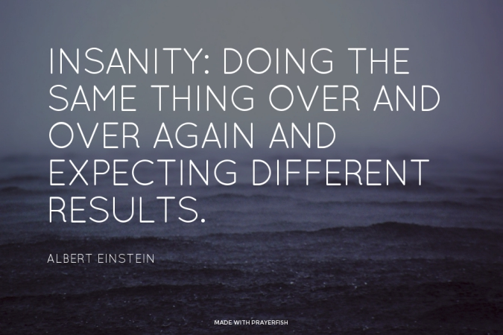
Questions

